Slide 1
Inverse Kinematics

Slide 2
Inverse Kinematics
given the pose of the end effector, find the joint variables that produce the end effector pose
for a 6-joint robot, given find

Slide 3
RPP + Spherical Wrist

Slide 4
RPP + Spherical Wrist
solving for the joint variables directly is hard

Slide 5
Kinematic Decoupling
for 6-joint robots where the last 3 joints intersecting at a point (e.g., last 3 joints are spherical wrist) there is a simpler way to solve the inverse kinematics problem
use the intersection point (wrist center) to solve for the first 3 joint variables
inverse position kinematics
use the end-effector pose to solve for the last 3 joint variables
inverse orientation kinematics

Slide 6
RPP Cylindrical Manipulator
d₃
o_{c}
d₂
d₁
z_{c}
y_{c}
x_{c}
Given $o_{c}=\left[\begin{matrix}x_{c} \\ y_{c} \\ z_{c}\end{matrix}\right]$ find $θ_{1}^{},d_{2}^{},d_{3}^{}$

Slide 7
RPP Cylindrical Manipulator
d₃
o_{c}
d₂
d₁
z_{c}
y_{c}
x_{c}

Slide 8
RPP Cylindrical Manipulator
d₃
o_{c}
d₂
d₁
z_{c}
y_{c}
x_{c}

Slide 9
RPP Cylindrical Manipulator
d₃
o_{c}
d₂
d₁
z_{c}
y_{c}
x_{c}

Slide 10
RPP Cylindrical Manipulator
d₃
o_{c}
d₂
d₁
z_{c}
y_{c}
x_{c}

Slide 11
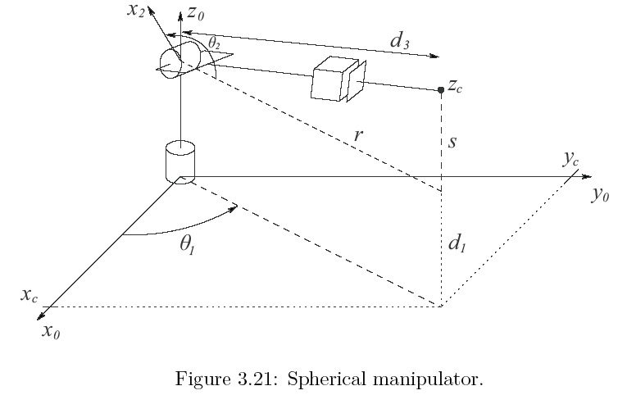
RRP Spherical Manipulator
Given $o_{c}=\left[\begin{matrix}x_{c} \\ y_{c} \\ z_{c}\end{matrix}\right]$ find $θ_{1}^{},θ_{2}^{},d_{3}^{}$

Slide 12
RRP Spherical Manipulator

Slide 13
RRP Spherical Manipulator

Slide 14
RRP Spherical Manipulator

Slide 15
RRP Spherical Manipulator

Slide 16
Spherical Wrist
Link | a_{i} | α_{i} | d_{i} | θ_{i}
4 | 0 | -90 | 0 | θ₄*
5 | 0 | 90 | 0 | θ₅*
6 | 0 | 0 | d₆ | θ₆*
* joint variable

Slide 17
Spherical Wrist

Slide 18
Spherical Wrist
o_{c}
o
d₆

Slide 19
Inverse Kinematics Recap
Solve for the first 3 joint variables q₁, q₂, q₃ such that the wrist center o_{c} has coordinates
Using the results from Step 1, compute
Solve for the wrist joint variables q₄, q₅, q₆ corresponding to the rotation matrix

Slide 20
Spherical Wrist
for the spherical wrist

Slide 21
Spherical Wrist

Slide 22
Spherical Wrist

Slide 23
Spherical Wrist
if θ₅ = 0

Slide 24
Spherical Wrist
continued from previous slide
only the sum θ₄+θ₆
can be determined

Slide 25
Using Inverse Kinematics in Path Generation

Slide 26
Path Generation
a path is defined as a sequence of configurations a robot makes to go from one place to another
a trajectory is a path where the velocity and acceleration along the path also matter

Slide 27
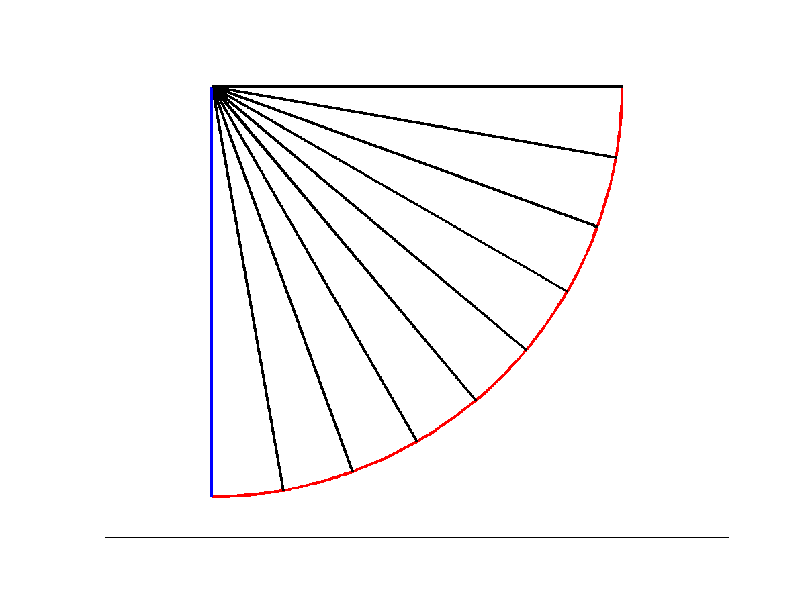
Joint-Space Path
a joint-space path is computed considering the joint variables
link 2
link 1
end effector path

Slide 28
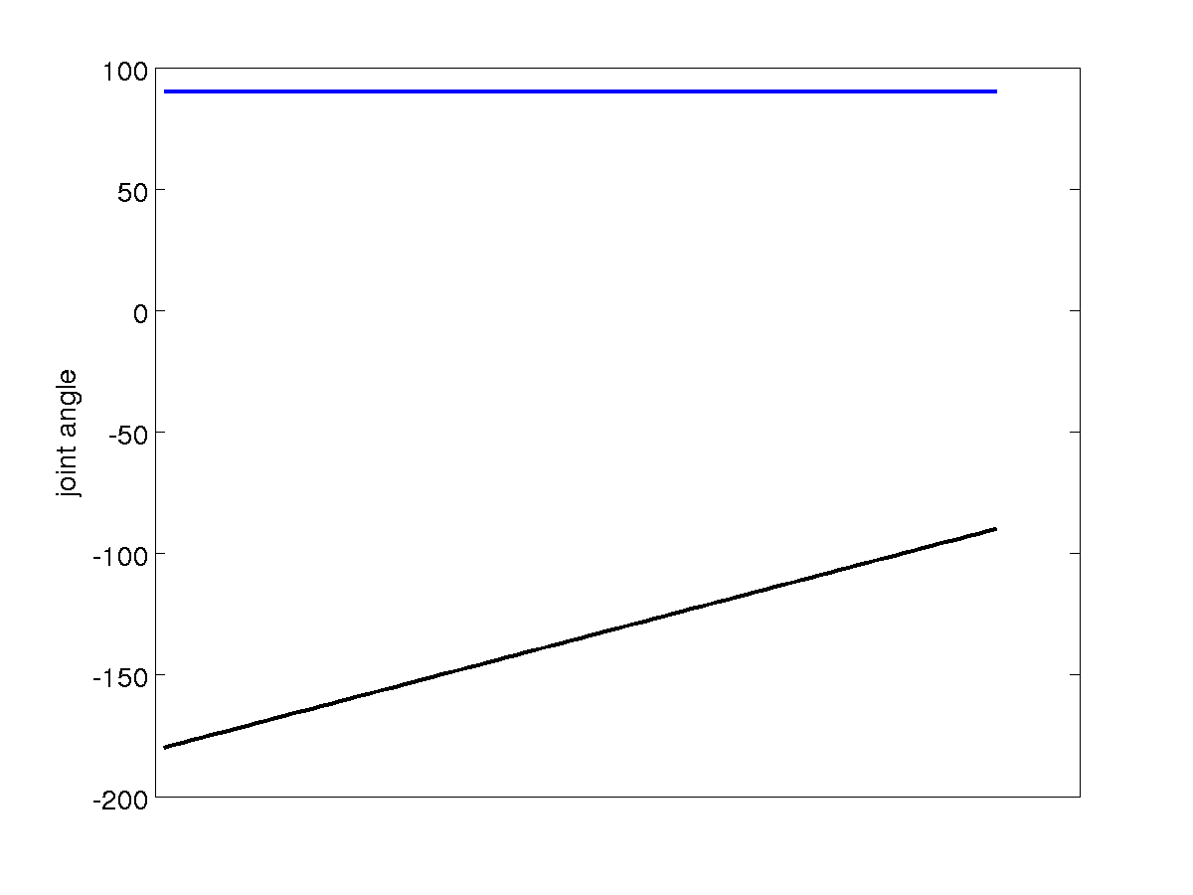
Joint-Space Path Joint Angles
linear joint-space path
link 1
link 2

Slide 29
Joint-Space Path
given the current end-effector pose and the desired final end-effector pose find a sequence of joint angles that generates the path between the two poses
idea
solve for the inverse kinematics for the current and final pose to get the joint angles for the current and final pose
interpolate the joint angles

Slide 30
Joint-Space Path
⇒ inverse kinematics ⇒
⇒ inverse kinematics ⇒

Slide 31
Joint-Space Path
find ⁰Q from ⁰T
find ^{f}Q from ^{f}T
Δ t = 1 / m
ΔQ = ^{f}Q – ⁰Q
for j = 1 to m
t_{j} = j Δ t
^{j}Q = ⁰Q + t_{j} Δ Q
set joints to ^{j}Q
end

Slide 32
Joint-Space Path
linearly interpolating the joint variables produces
a linear joint-space path
a non-linear Cartesian path
depending on the kinematic structure the Cartesian path can be very complicated
some applications might benefit from a simple, or well defined, Cartesian path

Slide 33
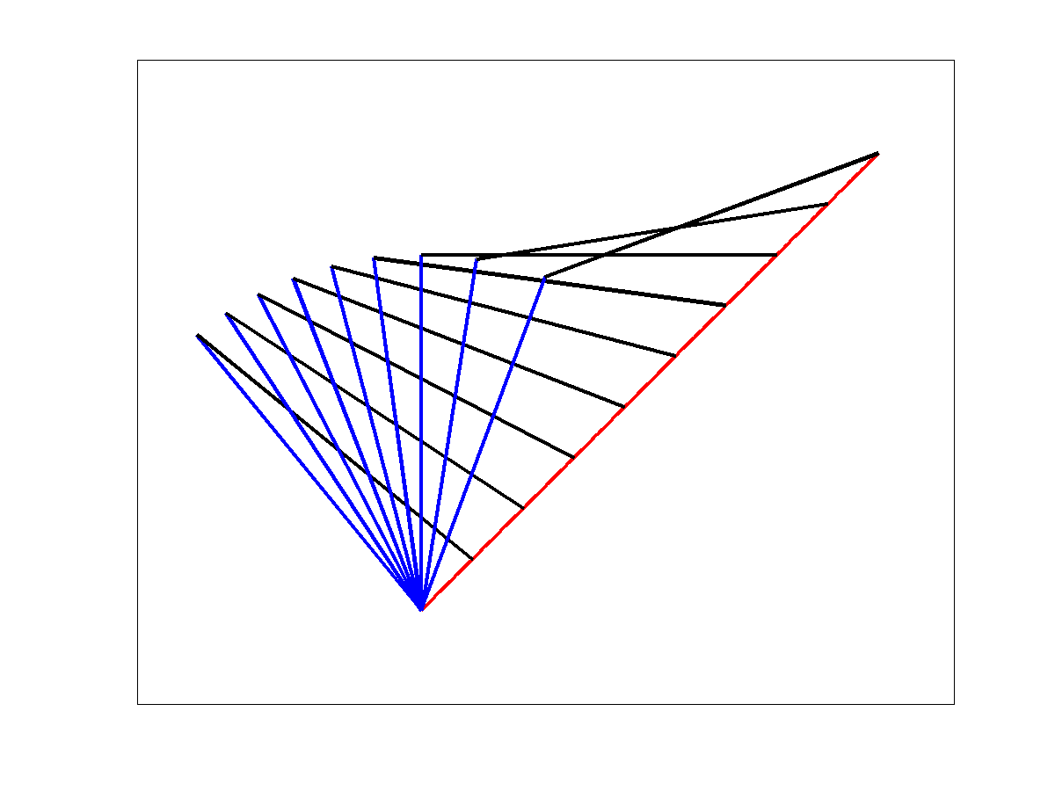
Cartesian-Space Path
a Cartesian-space path considers the position of end-effector
link 2
end effector path
link 1

Slide 34
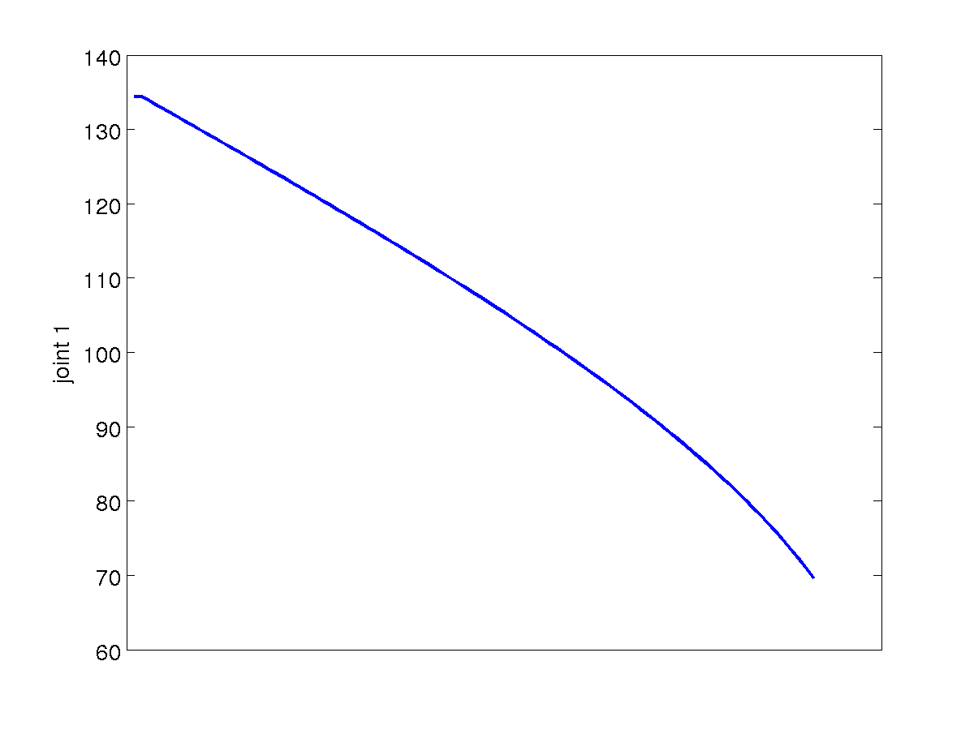
Cartesian-Space Path Joint Variable 1
non-linear joint-space path

Slide 35
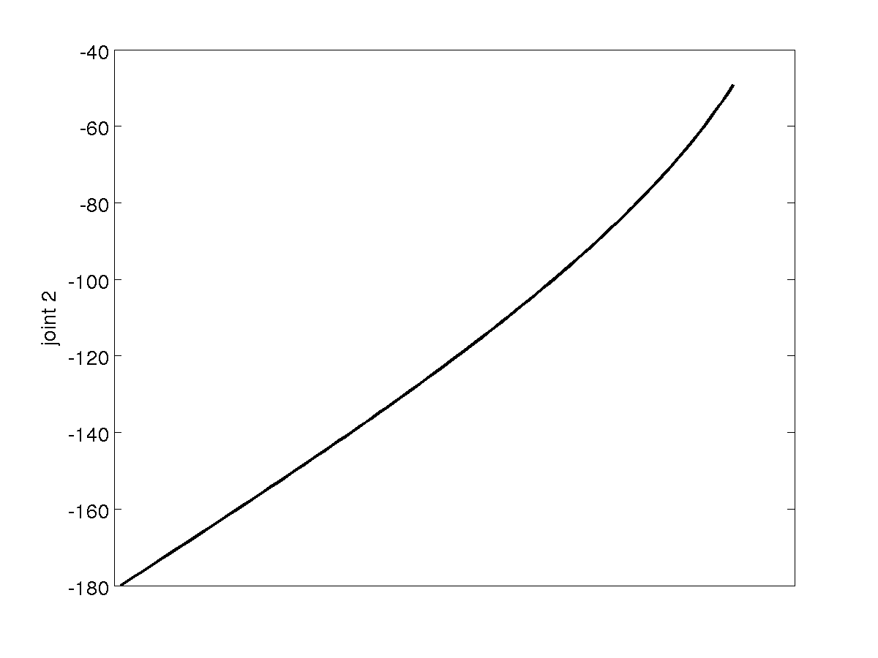
Cartesian-Space Path Joint Variable 2
non-linear joint-space path

Slide 36
Issues with Cartesian-Space Paths

Slide 37
Joint Velocity Issues
consider the RR robot shown below
assume that the second joint can rotate by ±180 degrees

Slide 38
Joint Velocity Issues
what happens when it is commanded to follow the straight line path shown in red?

Slide 39
Joint Velocity Issues

Slide 40
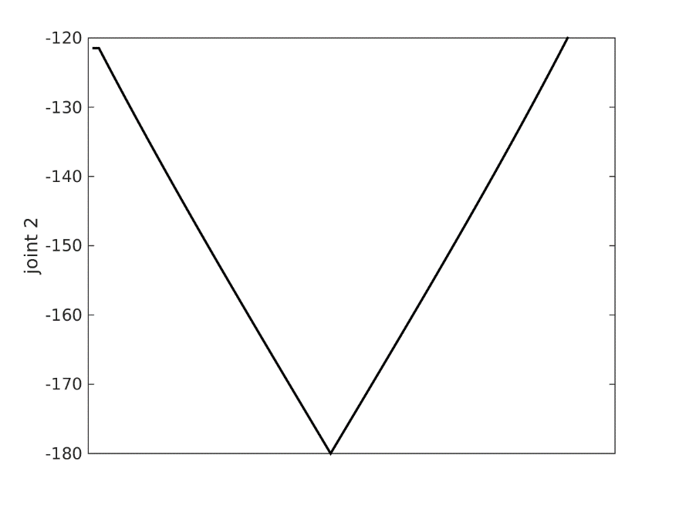
Joint Velocity Issues
jump discontinuity in first derivative = infinite rotational acceleration
steep slope = high rotational velocity

Slide 41
Workspace
the reachable workspace of a robot is the volume swept by the end effector for all possible combinations of joint variables
i.e., it is the set of all points that the end effector can be moved to

Slide 42
Workspace
consider the RR robot shown below
assume both joints can rotate by 360 degrees

Slide 43
Workspace
rotating the second joint through 360 degrees sweeps out the set of points on the dashed circle

Slide 44
Workspace
rotating the first and second joints through 360 degrees sweeps out the set of all points inside the outer dashed circle

Slide 45
Workspace
workspace consists of all of the points inside the gray circle

Slide 46
Workspace
workspace consists of all of the points inside the gray circle

Slide 47
Workspace
consider the RR robot shown below where the second link is shorter than the first
assume both joints can rotate by 360 degrees

Slide 48
Workspace
rotating the second joint through 360 degrees sweeps out the set of points on the dashed circle

Slide 49
Workspace
workspace consists of all of the points inside the gray area

Slide 50
Workspace
consider the following straight line path shown in red
start point, end point, and all points in between are reachable

Slide 51
Workspace
consider the following straight line path shown in red
start point and end point are reachable, but some points in between are not reachable

Slide 52
Paths satisfying end point constraints

Slide 53
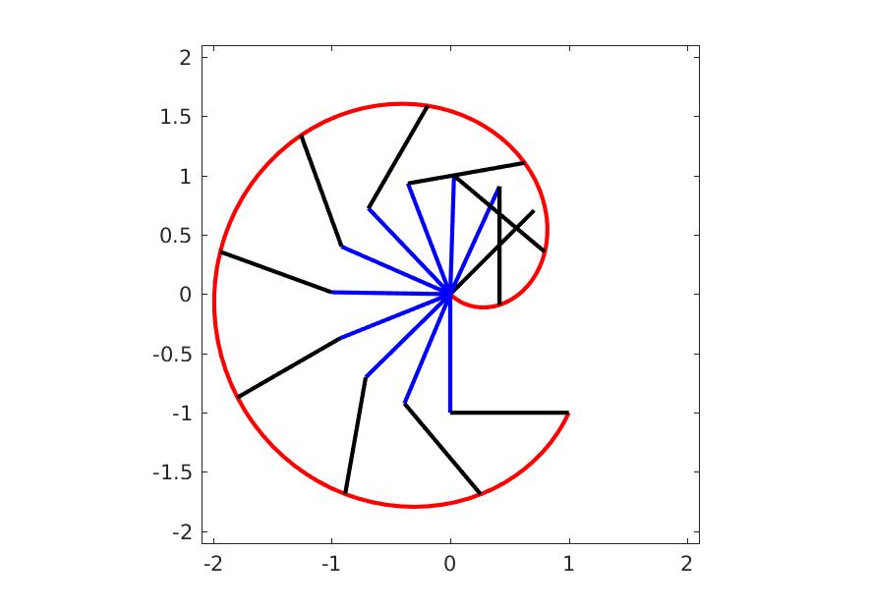
Joint-Space Path
a joint-space path is computed considering the joint variables
link 1
link 2
end effector path

Slide 54
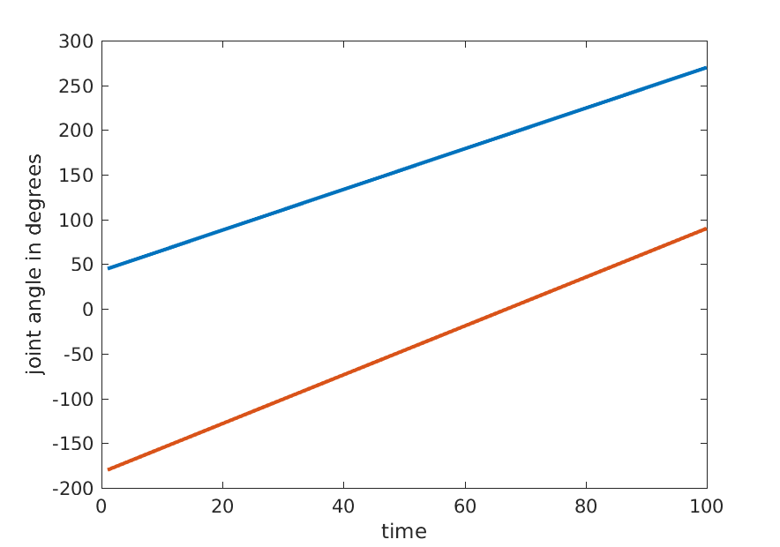
Joint-Space Path Joint Angles
linear joint-space path
link 1
link 2

Slide 55
Constraints
in the previous example we had two constraints for joint 1:
${}_{}^{0}{θ_{1}=60}$
${}_{}^{f}{θ_{1}=270}$
the simplest path satisfying these constraints is the straight line path
if we add more constraints then a straight line path may not be able to satisfy all of the constraints

Slide 56
Velocity constraints
a common constraint is that the robot starts from a stationary position and stops at a stationary positions
in other words, the joint velocities are zero at the start and end of the movement
${}_{}^{0}{\left(\frac{{dθ}_{1}}{dt}\right)}={}_{}^{0}{{\dot{θ}}_{1}}=0$
${}_{}^{f}{\left(\frac{{dθ}_{1}}{dt}\right)}={}_{}^{f}{{\dot{θ}}_{1}}=0$
more generally, we might require non-zero velocities
${}_{}^{0}{\left(\frac{{dθ}_{1}}{dt}\right)}={}_{}^{0}{{\dot{θ}}_{1}}={}_{}^{0}v$
${}_{}^{f}{\left(\frac{{dθ}_{1}}{dt}\right)}={}_{}^{f}{{\dot{θ}}_{1}}={}_{}^{f}v$

Slide 57
Acceleration constraints
for smooth motion, we might require that the acceleration at the start and end of the motion be zero
${}_{}^{0}{\left(\frac{{d^{2}θ}_{1}}{dt^{2}}\right)}={}_{}^{0}{{\ddot{θ}}_{1}}=0$
${}_{}^{f}{\left(\frac{{d^{2}θ}_{1}}{dt^{2}}\right)}={}_{}^{f}{{\ddot{θ}}_{1}}=0$
more generally, we might require non-zero accelerations
${}_{}^{0}{\left(\frac{{d^{2}θ}_{1}}{dt^{2}}\right)}={}_{}^{0}{{\ddot{θ}}_{1}}={}_{}^{0}α$
${}_{}^{f}{\left(\frac{{d^{2}θ}_{1}}{dt^{2}}\right)}={}_{}^{f}{{\ddot{θ}}_{1}}={}_{}^{f}α$

Slide 58
Satisfying the constraints
given some set of constraints on a joint variable $q$ our goal is to find $q\left(t\right)$ that satisfies the constraints
there are an infinite number of choices for $q\left(t\right)$
it is common to choose “simple” functions to represent $q\left(t\right)$

Slide 59
Satisfying the constraints with polynomials
suppose that we choose $q\left(t\right)$ to be a polynomial
if we have $n$ constraints then we require a polynomial with $n$ coefficients that can be chosen to satisfy the constraints
in other words, we require a polynomial of degree $\left(n−1\right)$

Slide 60
Satisfying the constraints with polynomials
suppose that we have joint value and joint velocity constraints
$q\left(t_{0}\right)=q_{0}$
$q\left(t_{f}\right)=q_{f}$
$\dot{q}\left(t_{0}\right)=v_{0}$
$\dot{q}\left(t_{f}\right)=v_{f}$
we require a polynomial of degree 3 to represent $q\left(t\right)$
$q\left(t\right)=a+bt+ct^{2}+dt^{3}$
the derivative of $q\left(t\right)$ is easy to compute
$\dot{q}\left(t\right)=b+2ct+3dt^{2}$

Slide 61
Satisfying the constraints with polynomials
equating $q\left(t\right)$ and $\dot{q}\left(t\right)$ to each of the constraints yields:
$q\left(t_{0}\right)=q_{0}=a+bt_{0}+ct_{0}^{2}+dt_{0}^{3}$
$q\left(t_{f}\right)=q_{f}=a+bt_{f}+ct_{f}^{2}+dt_{f}^{3}$
$\dot{q}\left(t_{0}\right)=v_{0}=b+2ct_{0}+3dt_{0}^{2}$
$\dot{q}\left(t_{f}\right)=v_{f}=b+2ct_{f}+3dt_{f}^{2}$
which is a linear system of 4 equations with 4 unknowns ($a, b, c, d)$

Slide 62
Example
consider the following constraints where the robot is stationary at the start and end of the movement
$q\left(t_{0}\right)=θ\left(0\right)=10$
$q\left(t_{f}\right)=θ\left(3\right)=80$
$\dot{q}\left(t_{0}\right)=\dot{θ}\left(0\right)=0$
$\dot{q}\left(t_{f}\right)=\dot{θ}\left(3\right)=0$

Slide 63
Example: Joint angle
$$θ\left(3\right)=80$$
cubic
$$θ\left(0\right)=10$$

Slide 64
Example: Joint velocity
quadratic
$$\dot{θ}\left(0\right)=0$$
$$\dot{θ}\left(3\right)=0$$

Slide 65
Example: Joint acceleration
linear

Slide 66
Satisfying the constraints with polynomials
suppose that we have joint value, joint velocity, and joint acceleration constraints
$q\left(t_{0}\right)=q_{0}$
$q\left(t_{f}\right)=q_{f}$
$\dot{q}\left(t_{0}\right)=v_{0}$
$\dot{q}\left(t_{f}\right)=v_{f}$
$\ddot{q}\left(t_{0}\right)=α_{0}$
$\ddot{q}\left(t_{f}\right)=α_{f}$

Slide 67
Satisfying the constraints with polynomials
we require a polynomial of degree 5 to represent $q\left(t\right)$
$q\left(t\right)=a+bt+ct^{2}+dt^{3}+et^{4}+ft^{5}$
the derivatives of $q\left(t\right)$ are easy to compute
$\dot{q}\left(t\right)=b+2ct+3dt^{2}+4et^{3}+5ft^{4}$
$\ddot{q}\left(t\right)=2c+6dt+12et^{2}+20ft^{3}$

Slide 68
Satisfying the constraints with polynomials
equating $q\left(t\right)$, $\dot{q}\left(t\right)$, and $\ddot{q}\left(t\right)$ to each of the constraints yields:
$q\left(t_{0}\right)=q_{0}=a+bt_{0}+ct_{0}^{2}+dt_{0}^{3}$
$q\left(t_{f}\right)=q_{f}=a+bt_{f}+ct_{f}^{2}+dt_{f}^{3}$
$\dot{q}\left(t_{0}\right)=v_{0}=b+2ct_{0}+3dt_{0}^{2}$
$\dot{q}\left(t_{f}\right)=v_{f}=b+2ct_{f}+3dt_{f}^{2}$
$\ddot{q}\left(t_{0}\right)=α_{0}=2c+6dt_{0}+12et_{0}^{2}+20ft_{0}^{3}$
$\ddot{q}\left(t_{f}\right)=α_{f}=2c+6dt_{f}+12et_{f}^{2}+20ft_{f}^{3}$
which is a linear system of 6 equations with 6 unknowns ($a, b, c, d,e,f)$

Slide 69
Example
consider the following constraints where the robot is stationary at the start and end of the movement, and the joint accelerations are zero at the start and end of the movement
$q\left(t_{0}\right)=θ\left(0\right)=10$
$q\left(t_{f}\right)=θ\left(3\right)=80$
$\dot{q}\left(t_{0}\right)=\dot{θ}\left(0\right)=0$
$\dot{q}\left(t_{f}\right)=\dot{θ}\left(3\right)=0$
$\ddot{q}\left(t_{0}\right)=\ddot{θ}\left(0\right)=0$
$\ddot{q}\left(t_{f}\right)=\ddot{θ}\left(3\right)=0$

Slide 70
Example: Joint angle
$$θ\left(3\right)=80$$
quintic
$$θ\left(0\right)=10$$

Slide 71
Example: Joint velocity
quartic
$$\dot{θ}\left(0\right)=0$$
$$\dot{θ}\left(3\right)=0$$

Slide 72
Example: Joint acceleration
cubic
$$\ddot{θ}\left(0\right)=0$$
$$\ddot{θ}\left(3\right)=0$$

